Slide 1
Health and Wholeness
Topic 13:
Fitness

Slide 2
Fitness defined
Dictionary: “the ability to perform daily tasks vigorously and alertly, with energy left over for enjoying leisure-time activities and meeting emergency demands.”
Practical: “the ability to endure, bear up, withstand stress, to carry on in circumstances where an unfit person could not continue, and is a major basis for good health and well-being."

Slide 3
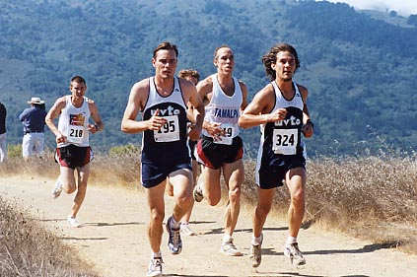
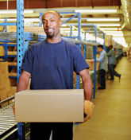
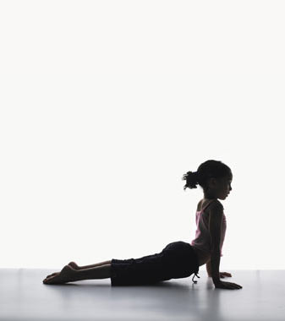
Three Major Results of Fitness
Endurance – ability to sustain an activity
Strength – ability to lift/carry a great burden for a short time
Flexibility – can bend, stretch, or adapt as circumstances dictate

Slide 4
 | Endurance | Strength | Flexibility
Physical | Don’t loose breath, tire out | Lift and carry weight | Bend, reach far
Social | Long term peers, mentors | People you can depend on | Make friends In new situations
Mental | Hold up over time | Withstand intense Pressure | Adapt to new Situations
Spiritual | Withstand testing | Avoid temptations | Adapt as He calls you

Slide 5
Physical fitness has benefits
Reduced risk of heart disease, high blood pressure, diabetes
Reduced risk of injury
Improved healing from illness, injury by boosting your immune system
Improved mental functioning
Improved energy, endurance

Slide 6
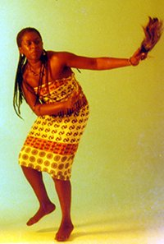
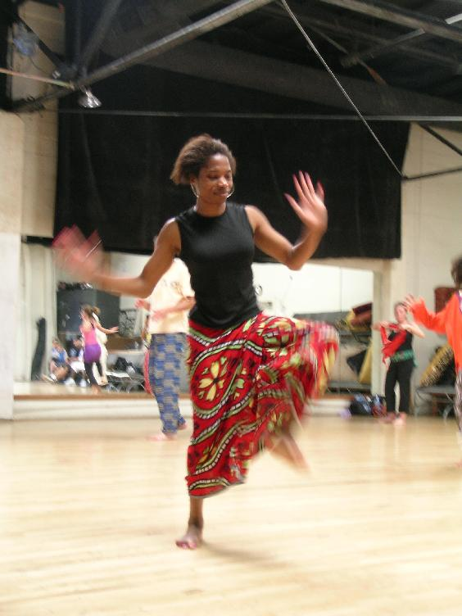
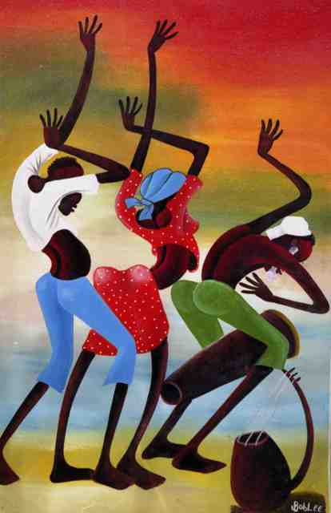
Aerobic exercise
Moves large muscle groups, breathe more deeply
Improves the health of your
heart and lungs
Walking, jogging, aerobic
dance, bicycling,
swimming
Key: Target Heart Rate

Slide 7
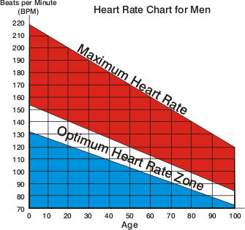
Target Heart Rate:
Men

Slide 8
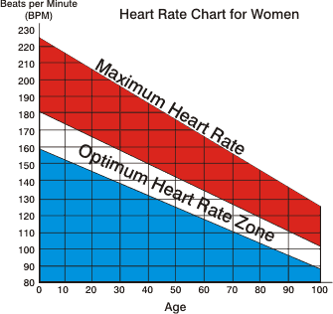
Target Heart Rate: Women

Slide 9
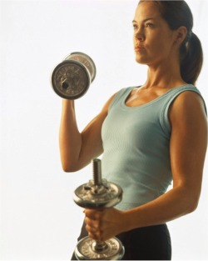
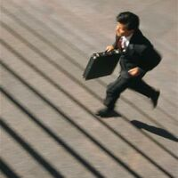
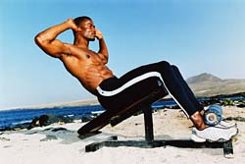
Weight-bearing Exercise
Exercise against force of gravity, build muscle – leaves muscles and bones strong
Weight lifting,
climbing stairs

Slide 10
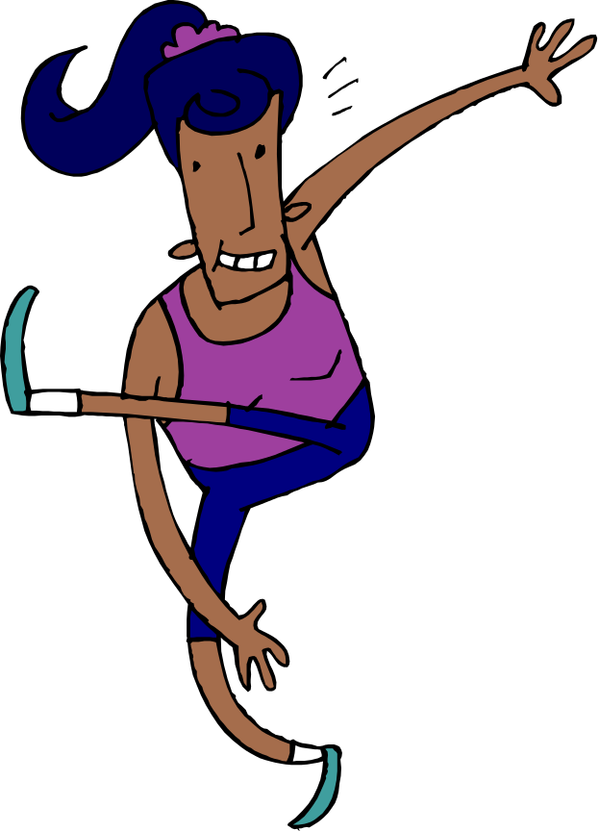
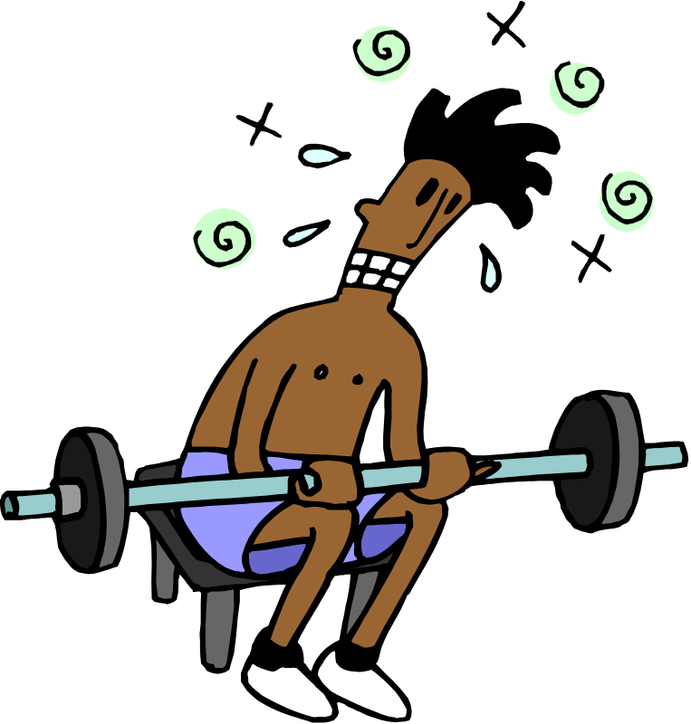
The BEST exercise: is the one you do regularly!

Slide 11
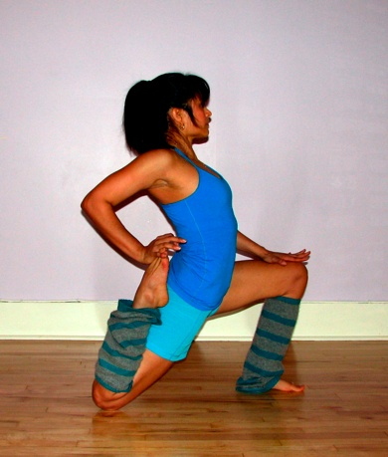
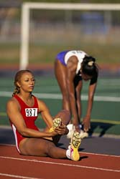
How much do you need?
4-6 days per week for 30 minutes is very good.
Anything done regularly is good.
It should include a mix during week of weight and aerobic.
After warmed up a little,
STRETCH.

Slide 12

Good 60 minute Routine for 2-4 times per week
5 min warm up – walk/slow jog
5 min stretching
20 min aerobic workout – reaching target heart rate
15 min weight bearing
10 min rigorous but safe
stretching
5 min cool down – slow walk

Slide 13

Be Careful
Prevent injuries – stretch
Listen to your body. Stop if you feel dizzy or pain.
Consult a doctor before exercising if you are pregnant, over 35 years old or if high blood pressure, stroke or heart disease runs in the family
It’s normal to be sore the next day if you haven’t exercised for awhile but if you are in a lot of pain then stop.

Slide 14



Stick to it!
Join a running group
Work out with a friends
Start a new group sport
It’s easier to stick to it when you have other people counting on you and giving you encouragement
Vary the routine to prevent boredom and get a better work out

Slide 15
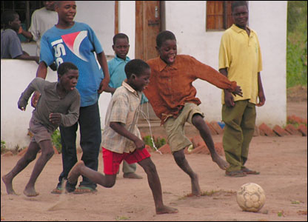
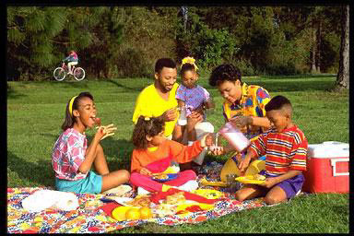
Social fitness ideas
Spend time with
family!
Constructive activities with friends
Share a meal with someone
Meet friends for lunch
Have time with a mentor,
mentor someone:
breakfast meetings are
great.

Slide 16
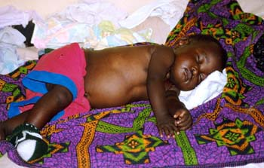
Emotional Fitness
-Leisure skills
-Breaks and ‘get away’
-Counseling for difficult periods
-Stressed? Take a deep breathing
-Get enough sleep for your health!
-Practice good time management…
(he who wastes his time,
wastes other people’s time)

Slide 17


Counsel Others
Listen Reflectively
Don’t be afraid to admit that you don’t know what to do and refer your friend to a counselor
Practice Active Listening

Slide 18

Time Management
Time management: God gave us 168 hours/week so steward them like they are money.
Pray, assign priorities to different tasks.
Each week make an A, B, and C list. Put due dates on A list items. Get those done, plus some B items and 1-2 C items.
Remember!!! (he who wastes his time, wastes other people’s time)

Slide 19

Time Management, cont.
Break down larger projects into smaller tasks
Think of the entire project so you aren’t dealing with an emergency. Think ahead.
Respect other people’s time. This helps them manage their time too. If you run over time on something, other people are affected too.

Slide 20

Schedule
Make working out a part of your schedule
Stick to it!
Don’t let it be interrupted
Even if you’re tired once you get started the energy will come
Monitor progress

Slide 21


Reward
When you stick to your schedule buy a new shirt
No chips or chocolate bars
You’ll feel better about your body so don’t destroy your progress with junk food
Be proud of yourself!

Slide 22
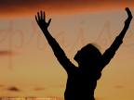

Spiritual Fitness Ideas
Faithful relationship with God
Worship in a healthy, balanced church.
Seek Knowledge of God
Devote to daily reading, meditation
Fellowship with other believers.
Accountability: submit to others

Slide 23

The Whole Truth
1 Corinthians 9:24 Do you not know that in a race all the runners run, but only one gets the prize? Run in such a way as to get the prize. 25 Everyone who competes in the games goes into strict training. They do it to get a crown that will not last; but we do it to get a crown that will last forever. 26 Therefore I do not run like a man running aimlessly; I do not fight like a man beating the air. 27 No, I beat my body and make it my slave so that after I have preached to others, I myself will not be disqualified for the prize.

Slide 24
What are the likely consequences to our overall health for our failure to understand and manage sexuality?

